Slide 1
FlappyCat
(name subject to change)
By Brady Huston and Linguo Zhu (Joey)

Slide 2
Goals:
- Use all of our own artwork
- Deploy to the “big 3” (iOS, Android, WinPhone8)
- Make it look good
- Keep track of high score
- Sounds

Slide 3

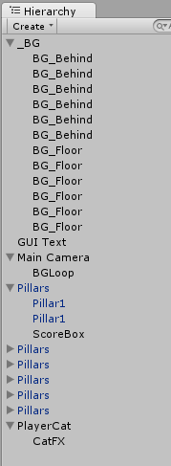
Class hierarchy: = amazing
Background
Camera (looper)
Pillars (scorebox)
Player (FX)

Slide 4
Class concepts
Carry principle: device orientation is fixed portrait
Why? Landscape has an unfair advantage.
Feedback: people want it for games. High score is mandatory feature

Slide 5
Results:
Running on an Android device!
Running on Pete’s Phone!
Core functionality is present!
Resolution got really weird!
A flying cat!

Slide 6
Demo!

Slide 7
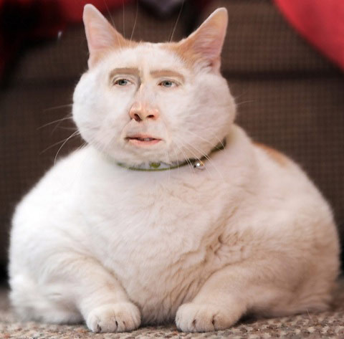
Post-mortem…
The game “works”! .. just be careful
Never ending game.. Success! (if skills permit)
The game is difficult. (of course)
Cat theme was a great success

